Slide 1
Faculty Workload Guideline
January 2026

Slide 2
Timeline
1993: Review based on direction of ODHE
  Tenure track faculty – Standard for workload (>70% of total faculty)
  Lecturers: standard for 100% teaching load (8 x 3 credit hours: 24 CH)
2023-2024: four phases of review
  First review (spring 2023) – Faculty compensation taskforce
  Second review (fall 2023) – Council of Deans (x3); Senate leadership (x3); departments, schools, colleges
  Third review (early spring 2024)– Provost Senate Taskforce
  Final review and approval (late spring-summer 2024) – Council of Deans/Provost Office

Slide 3
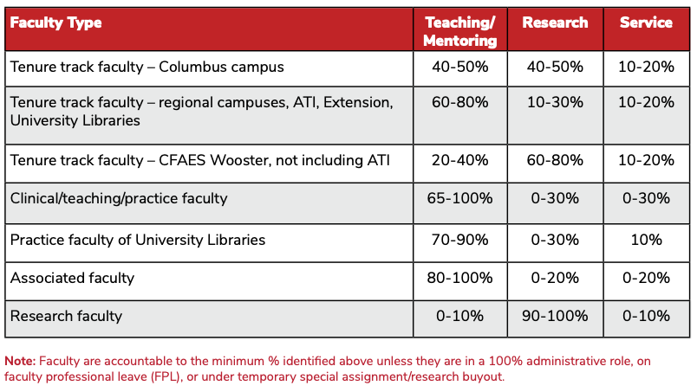
Broader faculty groups (1/3 – 1/3 – 1/3)

Slide 4
SB1
Summer 2025: Elements required based on direction of SB1
  Incorporate commercialization into the definitions of faculty duties (include criteria and evidence as part of the tenure review criteria).
  Better identify an accountability measure for defining equivalencies for work effort with respect to SCHs. Develop guidance language for POA guidelines to help units create equivalencies that are locally relevant. The process of approval will run through the governance review process centered in OAA.
  Better define the administrative action process in annual evaluations (04 process).
  Incorporate an affirmation statement in the Workload Guideline
  Fall 2025: Elements required based on guidance of ODHE

Slide 5
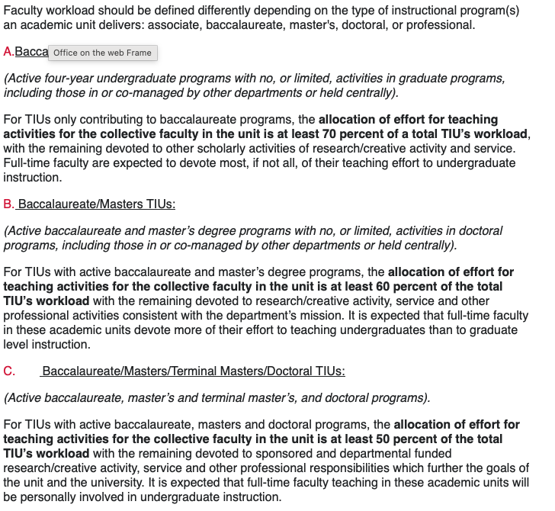
ODHE

Slide 6
Timeline
Spring 2025: Workstream in preparation to comply with SB1
  Taskforce – all senate members of prior review taskforce (6)
  Additional members: members of SB1 steering committee (4); associate deans representing ASC, COM, Engineering
Fall 2025:
  October-November – Alignment of 2024 guideline to the new ODHE guidance
  December – Final review and approval (unanimous approval from workgroup).
  December 19: publication of interim policy and Workload Standards and Guidelines.

Slide 7
Workload guideline
New guideline posted on Faculty Affairs (faculty.osu.edu) website (equitable policies)
https://faculty.osu.edu/faculty-support/equitable-policies/faculty-workload-guideline

Slide 8
Questions?

Slide 9
Main New Recommendations
That workload hours should focus on % time allocated to “dimensions” of responsibilities (e.g. research, teaching, service, clinical care) with respect to 100% FTE in an equitable and proportional way across 9-months and 12-months faculty.
Each unit should re-evaluate the credit-hour requirement (and equivalencies) needed in an equitable and proportional way across 9-months and 12-months faculty.
If TIUs have tenure track faculty on regional campuses (Lima, Mansfield, Marion, Newark), then their workload expectations and APT documents should align to allow faculty to achieve the specific criteria required for promotion, given the higher proportion of time allocated to teaching duties for regional campus faculty compared to tenure track faculty on the Columbus Campus.
Our university workload guideline should eliminate the requirement that units align their overall teaching loads as a function of the level of degrees they offer (70%, 60%, and 50% of workload for baccalaureate, master's, doctoral/professional programs, respectively)
To ensure that workload guidelines are developed through a model of shared governance, the process of approval should include a faculty vote by all faculty in the academic unit, with enough time for faculty discussion

Slide 10
Proposed Implementation
The new faculty workload guideline should be integrated in the OAA Policies and Procedures Handbook in its scheduled summer 2024 review (June-July).
A workshop, on how to develop an equity-based workload, will be offered to new chairs in early fall to help the redesign of their governance documents.
Academic units not due to review their POAs in the coming year will be given a two-year window for incorporating the new policy guidance into their POAs. Any unit will be offered a support workshop to help redesign their workload.

Slide 11
Committee Members
Patrick Louchouarn (Taskforce Chair), Sr. Vice Provost for Faculty, OAA
Jan Neiger, Assistant Vice Provost for Academic Human Resources, OAA
Stephanie Seveau, Professor, Medicine, Chair Senate FCBC
Melvin Pascall, Professor, Food Science and Technology
Mark Ruegsegger, Professor of Practice, Biomedical Engineering
Cynthia Callahan, Associate Professor, English (Mansfield Campus)
Amy Barnes, Clinical Associate Professor, Educational Studies
Julie Byron, Clinical Professor, Veterinary Clinical Sciences

Slide 12
Committee Charge
Review and revise the OSU faculty workload guideline that was redesigned in 2023 by a sub-committee of the Tenure Track Faculty Compensation Committee
Consider the questions and comments provided by the Senate Leadership
  Guardrails to ensure that faculty are treated fairly, equitably and ethically across colleges
  Denominator for percent effort
  Confusion between what POA vs APT covers
  Workload of tenure-track faculty on regional campuses
  Associated Faculty and Research Faculty workload
  Encourage units to make faculty time commitments public

